Slide 1
High-Dimensional Space
林思涵
2019/10/24

Slide 2
感謝
杜憶萍老師
卉倫-2014
思齊-2017
定宏-2019

Slide 3
Outline
The Sphere and the Cube in Higher Dimensions
Other Issues

Slide 4
The Sphere and the Cube in Higher Dimensions

Slide 5
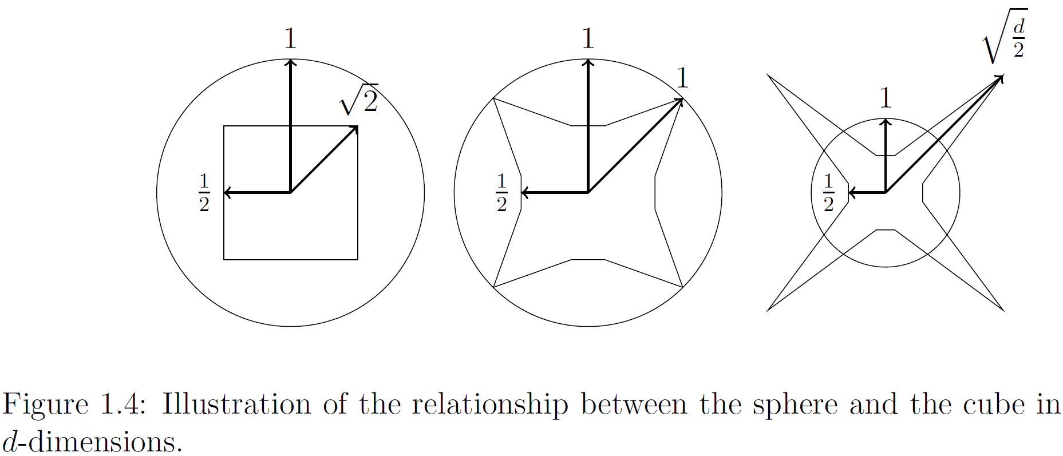


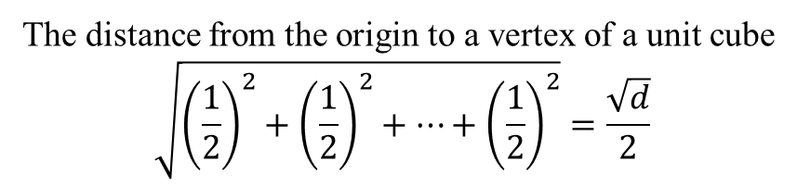
Centered at the origin
The distance from the origin to a vertex of a unit cube
$$\sqrt{{\left(\frac{1}{2}\right)}^{2}+{\left(\frac{1}{2}\right)}^{2}+⋯+{\left(\frac{1}{2}\right)}^{2}}=\frac{\sqrt{d}}{2}$$
The unit Sphere
The unit Cube
$$\frac{\sqrt{d}}{2}$$
$$\frac{\sqrt{2}}{2}$$
d=2
d=4
d

Slide 6
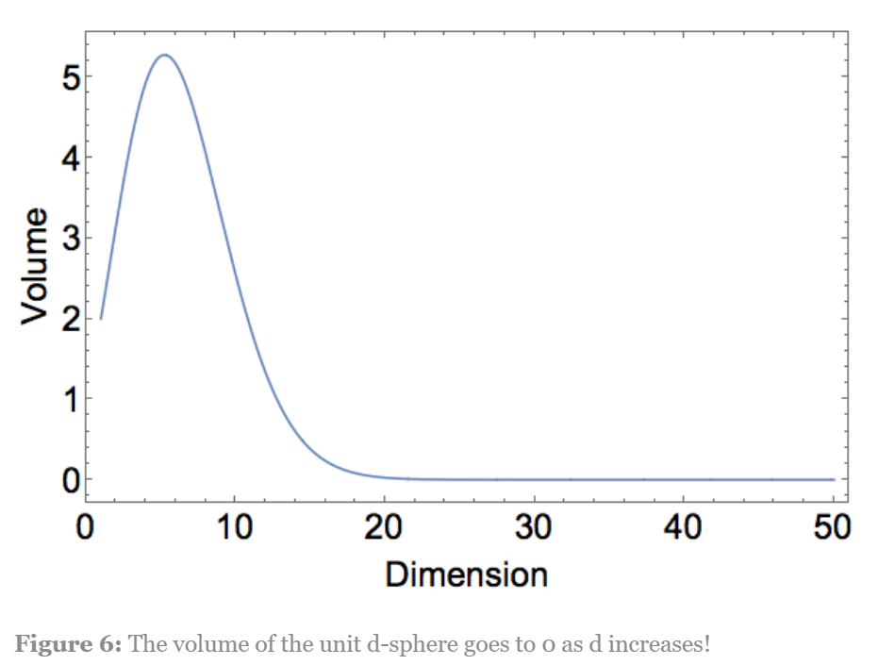
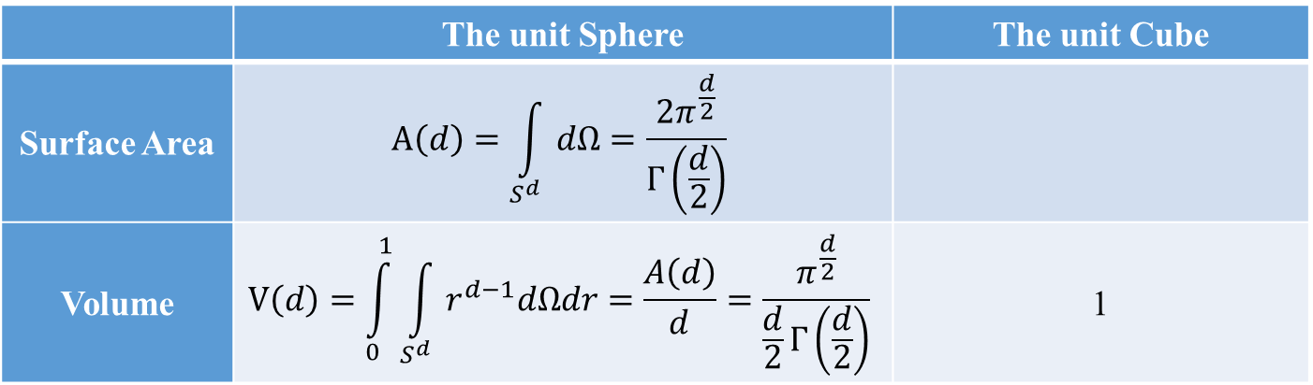
Volume and Surface Area
 | The unit Sphere | The unit Cube
Surface Area | $$A\left(d\right)=\int_{S^{d}}{dΩ}=\frac{2π^{\frac{d}{2}}}{Γ\left(\frac{d}{2}\right)}$$
Volume | $$V\left(d\right)=\int_{0}^{1}{\int_{S^{d}}{r^{d−1}dΩdr}}=\frac{A\left(d\right)}{d}=\frac{π^{\frac{d}{2}}}{\frac{d}{2}Γ\left(\frac{d}{2}\right)}$$ | 1

Slide 7
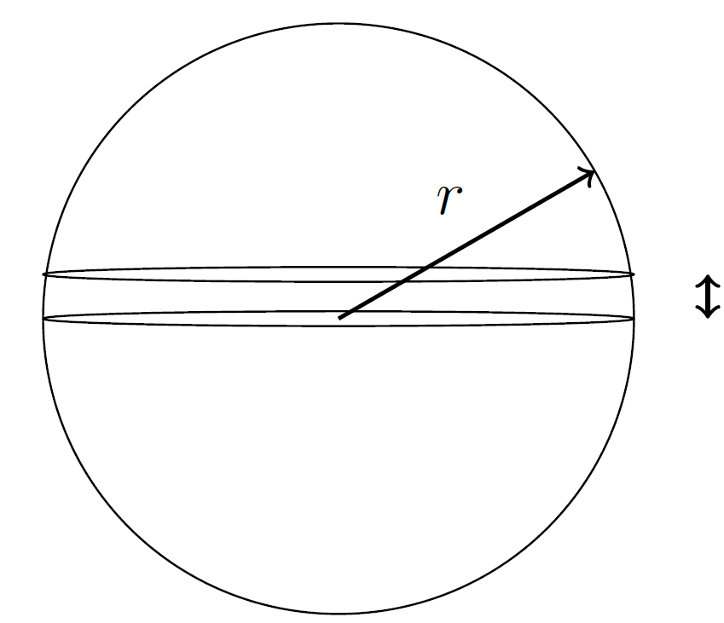
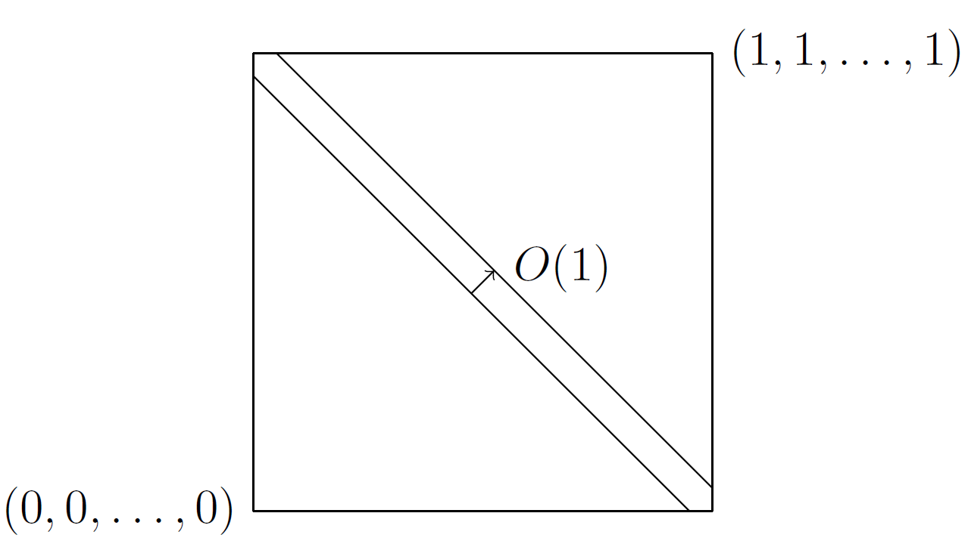
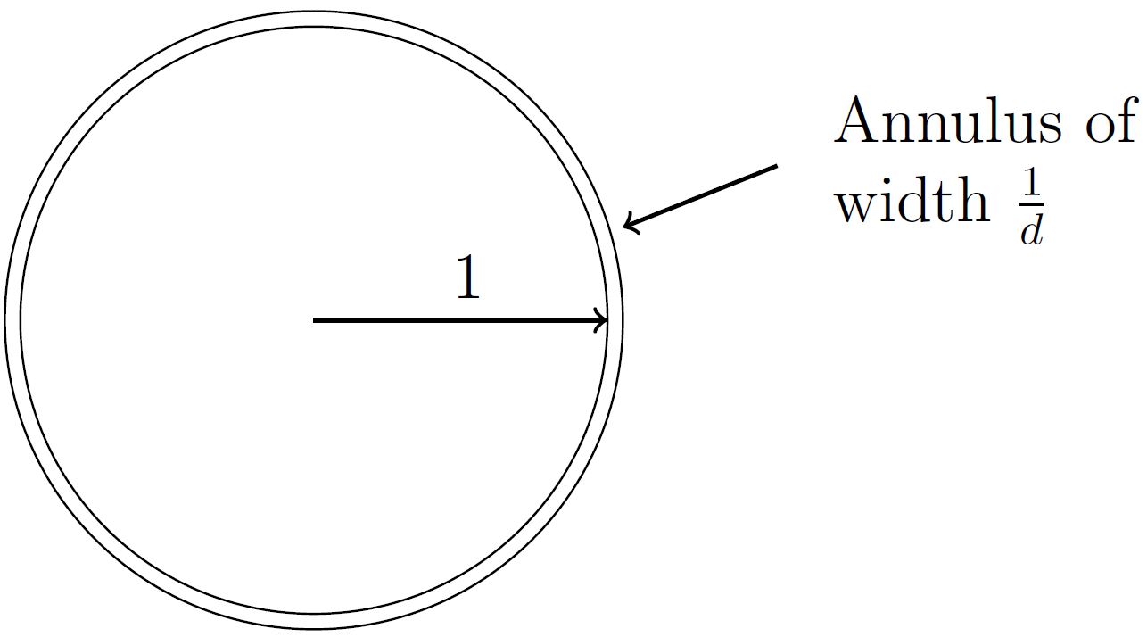
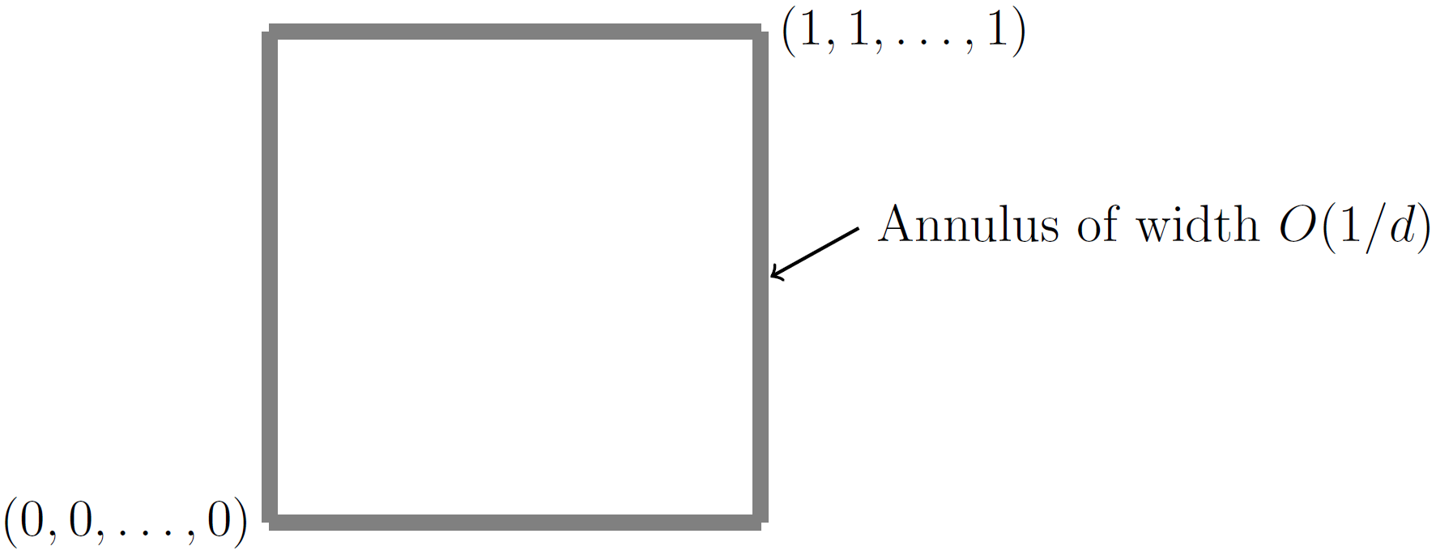

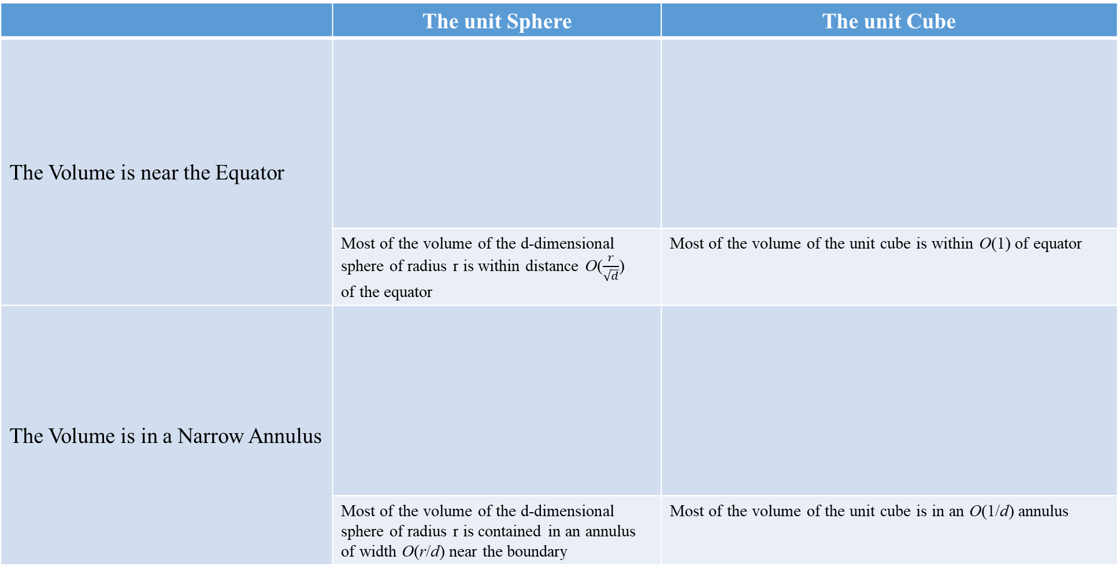

 | The unit Sphere | The unit Cube
The Volume is near the Equator
 | Most of the volume of the d-dimensional sphere of radius r is within distance O($\frac{r}{\sqrt{d}}$) of the equator | Most of the volume of the unit cube is within O(1) of equator
The Volume is in a Narrow Annulus
 | Most of the volume of the d-dimensional sphere of radius r is contained in an annulus of width O(r/d) near the boundary | Most of the volume of the unit cube is in an O(1/d) annulus
$$O\left(\frac{r}{\sqrt{d}}\right)$$
r
$$\frac{r}{d}$$

Slide 8
Other Issues
Generating Points Uniformly at Random from a Ball
Gaussians in High Dimension
Random Projection
Separating Gaussians

Slide 9
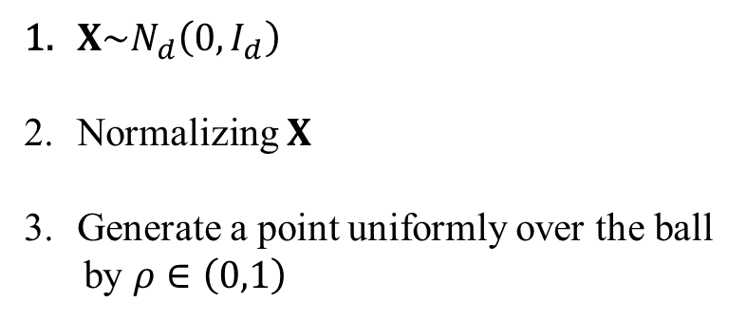

Generating Points Uniformly at Random from a Ball
$$y=ρ\frac{X}{\left|X\right|}$$
$X\sim N_{d}\left(0,I_{d}\right)$
Normalizing $X$
Generate a point uniformly over the ball
by $ρ∈\left(0,1\right)$

Slide 10
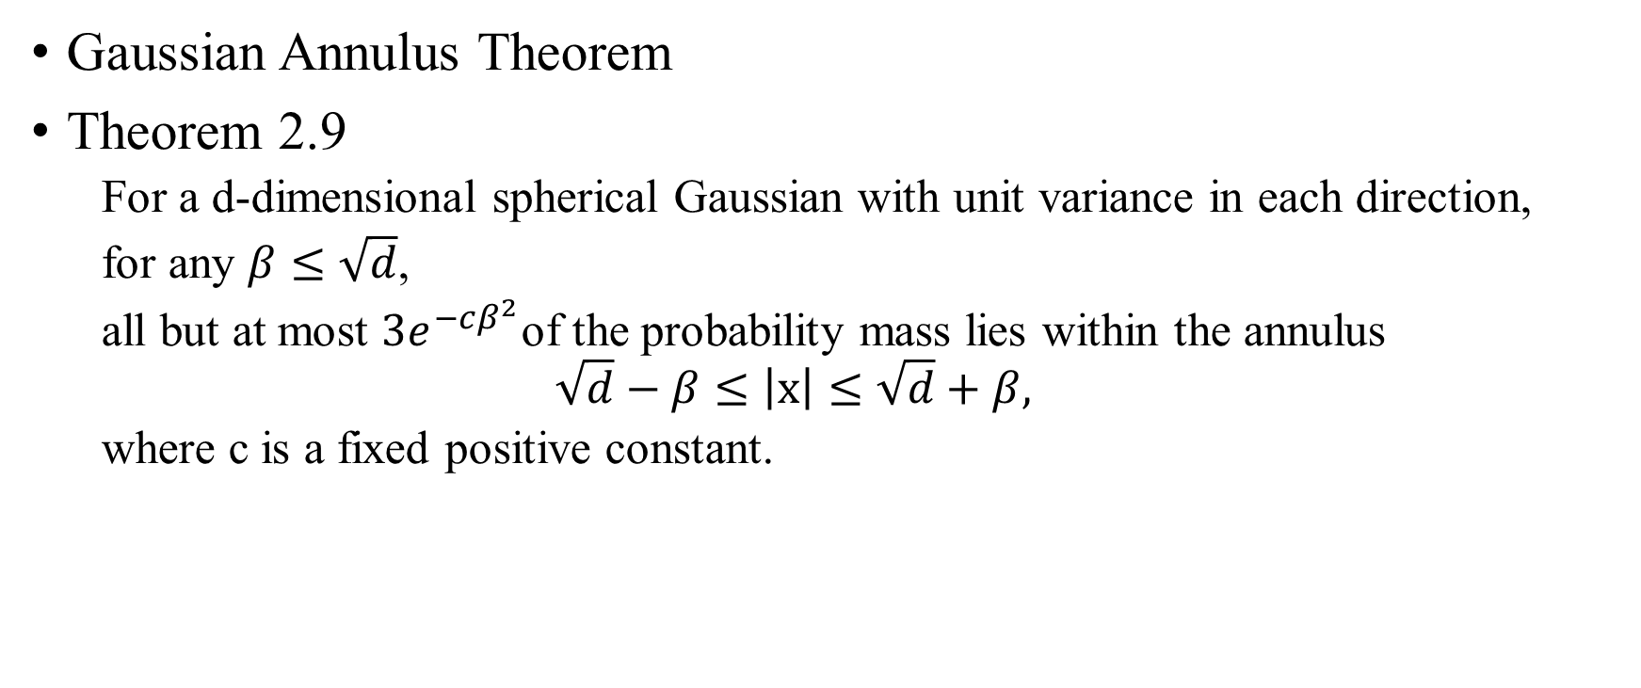
Gaussians in High Dimension
Gaussian Annulus Theorem
Theorem 2.9
For a d-dimensional spherical Gaussian with unit variance in each direction,
for any $β≤\sqrt{d}$,
all but at most $3e^{−cβ^{2}}$of the probability mass lies within the annulus
$$\sqrt{d}−β≤\left|x\right|≤\sqrt{d}+β,$$
where c is a fixed positive constant.

Slide 11
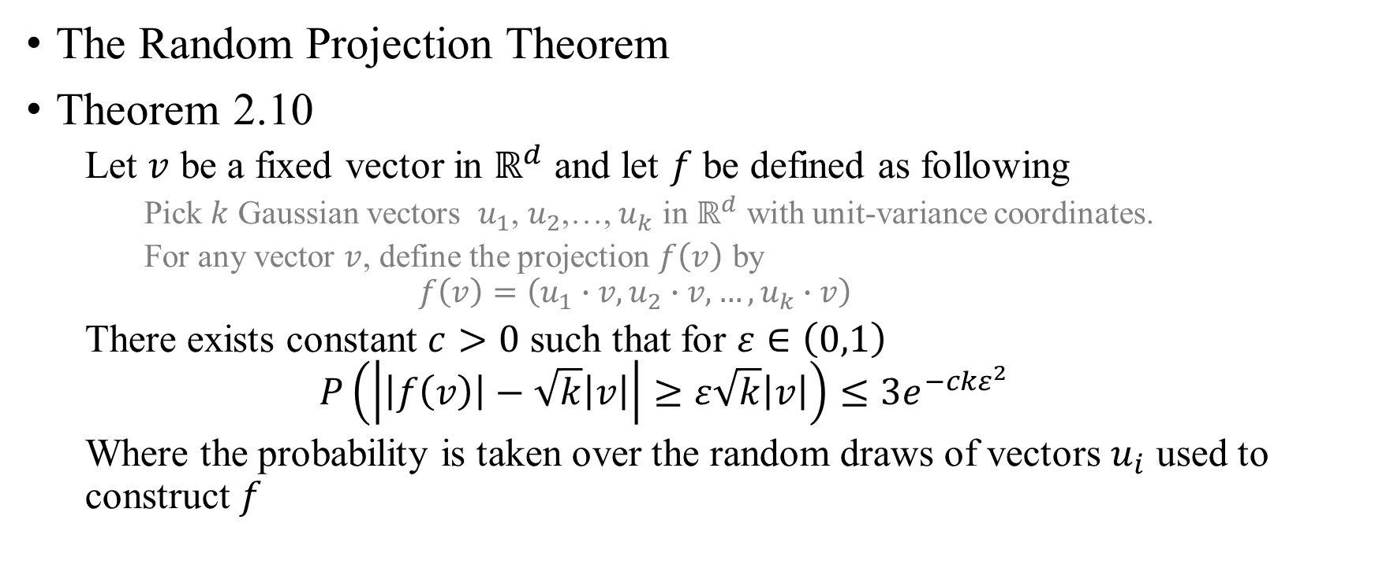
Random Projection
The Random Projection Theorem
Theorem 2.10
Let $v$ be a fixed vector in $ℝ^{d}$ and let $f$ be defined as following
Pick $k$ Gaussian vectors $u_{1}$, $u_{2}$,…, $u_{k}$ in $ℝ^{d}$ with unit-variance coordinates.
For any vector $v$, define the projection $f\left(v\right)$ by
$$f\left(v\right)=\left(u_{1}∙v,u_{2}∙v, …,u_{k}∙v\right)$$
There exists constant $c>0$ such that for $ε∈\left(0,1\right)$
$$P\left(\left|\left|f\left(v\right)\right|−\sqrt{k}\left|v\right|\right|≥ε\sqrt{k}\left|v\right|\right)≤3e^{−ckε^{2}}$$
Where the probability is taken over the random draws of vectors $u_{i}$ used to construct $f$

Slide 12
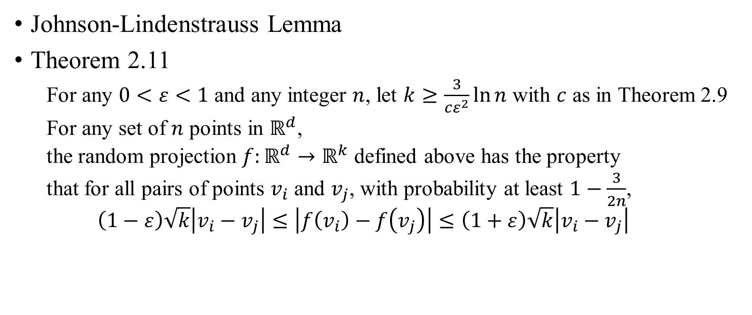
Johnson-Lindenstrauss Lemma
Theorem 2.11
For any $0<ε<1$ and any integer $n$, let $k≥\frac{3}{cε^{2}}\ln{n}$ with $c$ as in Theorem 2.9
For any set of $n$ points in $ℝ^{d}$,
the random projection $f:ℝ^{d}→ℝ^{k}$ defined above has the property
that for all pairs of points $v_{i}$ and $v_{j}$, with probability at least $1−\frac{3}{2n}$,
$$\left(1−ε\right)\sqrt{k}\left|v_{i}−v_{j}\right|≤\left|f\left(v_{i}\right)−f\left(v_{j}\right)\right|≤\left(1+ε\right)\sqrt{k}\left|v_{i}−v_{j}\right|$$

Slide 13
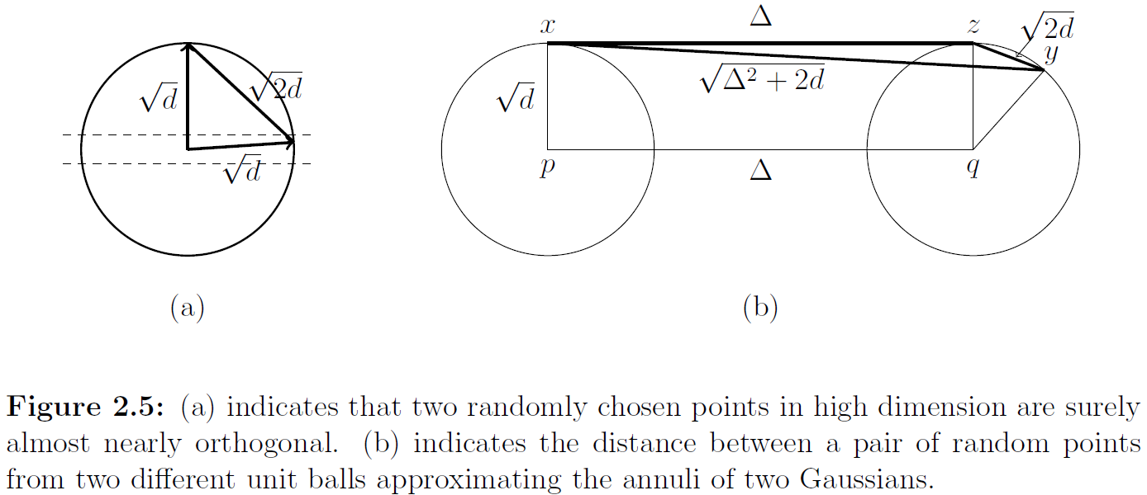
Separating Gaussians

Slide 14
Thank you

Slide 15

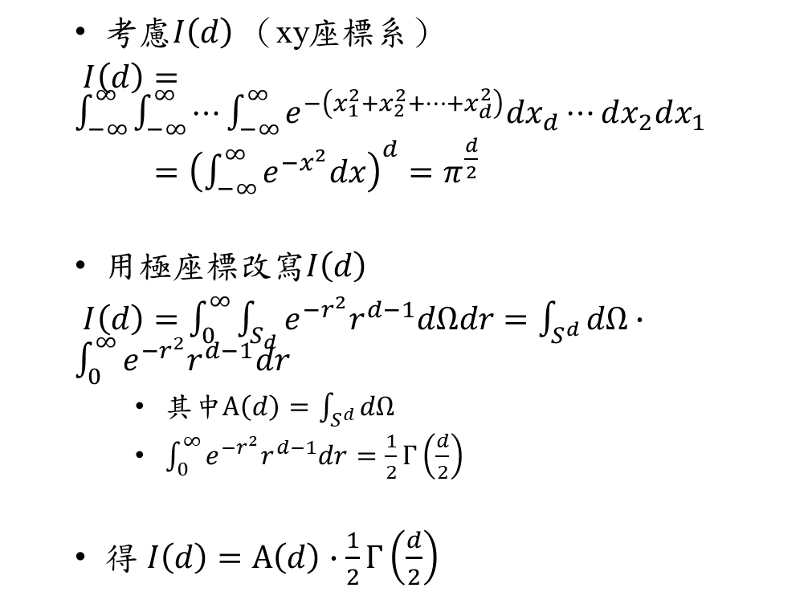
The volume and Surface Area of the sphere
考慮$I\left(d\right)$ （xy座標系）
$I\left(d\right)=\int_{−∞}^{∞}{\int_{−∞}^{∞}{⋯\int_{−∞}^{∞}{e^{−\left(x_{1}^{2}+x_{2}^{2}+⋯+x_{d}^{2}\right)}dx_{d}⋯dx_{2}dx_{1}}}}$
$I\left(d\right)={\left(\int_{−∞}^{∞}{e^{−x^{2}}dx}\right)}^{d}=π^{\frac{d}{2}}$
用極座標改寫$I\left(d\right)$
$I\left(d\right)=\int_{0}^{∞}{\int_{S_{d}}{e^{−r^{2}}r^{d−1}dΩdr}}=\int_{S^{d}}{dΩ}∙\int_{0}^{∞}{e^{−r^{2}}r^{d−1}dr}$
其中$A\left(d\right)=\int_{S^{d}}{dΩ}$
$\int_{0}^{∞}{e^{−r^{2}}r^{d−1}dr}=\frac{1}{2}Γ\left(\frac{d}{2}\right)$
得 $I\left(d\right)=A\left(d\right)∙\frac{1}{2}Γ\left(\frac{d}{2}\right)$
$$A\left(d\right)=\frac{2π^{\frac{d}{2}}}{Γ\left(\frac{d}{2}\right)}$$
$$V\left(d\right)=\frac{A\left(d\right)}{d}=\frac{π^{\frac{d}{2}}}{\frac{d}{2}Γ\left(\frac{d}{2}\right)}$$

Slide 16
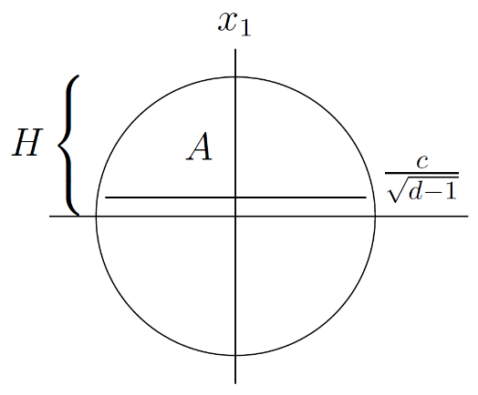
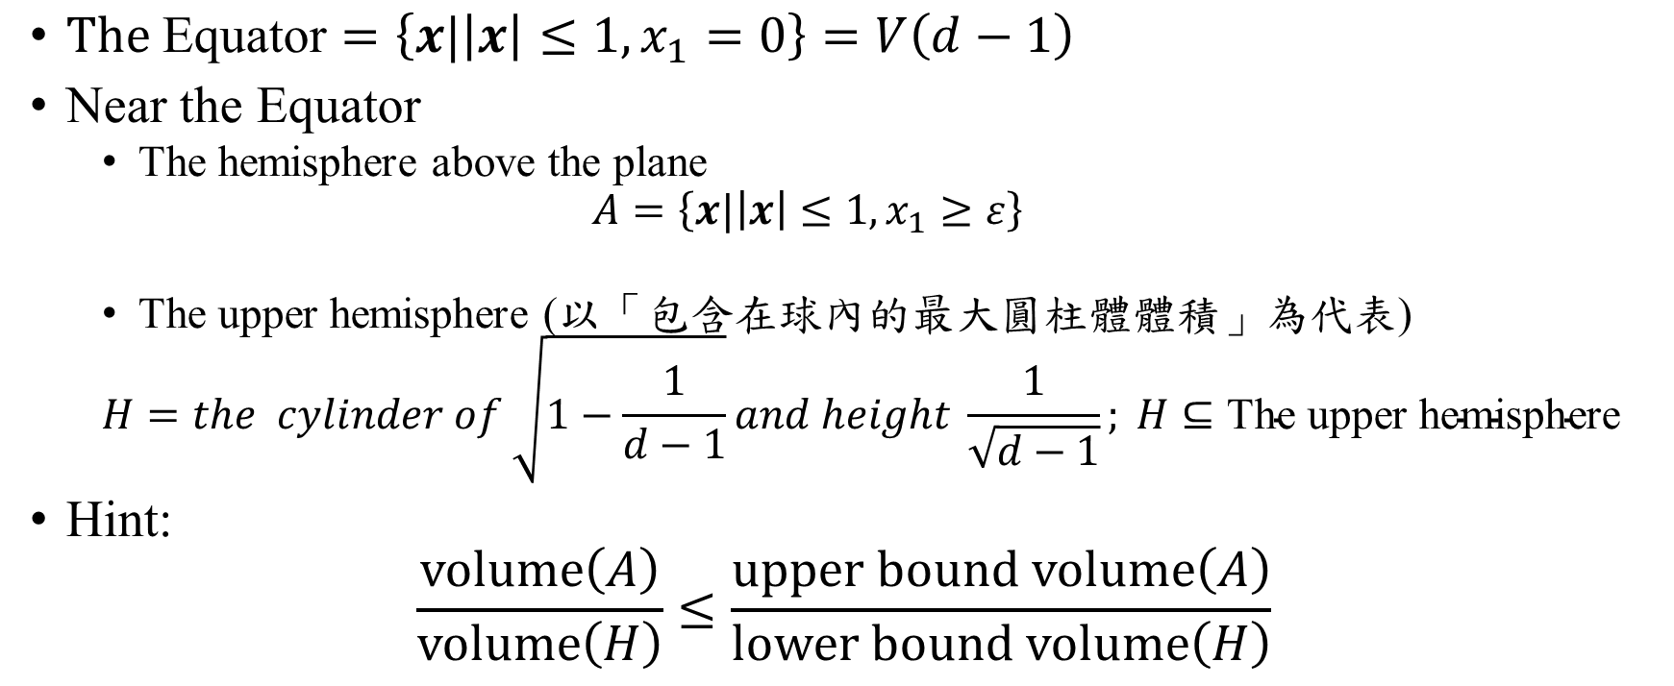
The unit Sphere The Equator
$\text{T}\text{he} \text{Equator}=\left\{x|\left|x\right|≤1,x_{1}=0\right\}=V\left(d−1\right)$
Near the Equator
The hemisphere above the plane
$$A=\left\{x|\left|x\right|≤1,x_{1}≥ε\right\}$$
The upper hemisphere (以「包含在球內的最大圓柱體體積」為代表)
$$H=the cylinder of \sqrt{1−\frac{1}{d−1}}and height \frac{1}{\sqrt{d−1}}; H⊆\text{The} \text{upper} \text{hemisphere}$$
Hint:
$$\frac{volume\left(A\right)}{volume\left(H\right)}≤\frac{upper bound volume\left(A\right)}{lower bound volume\left(H\right)}$$

Slide 17
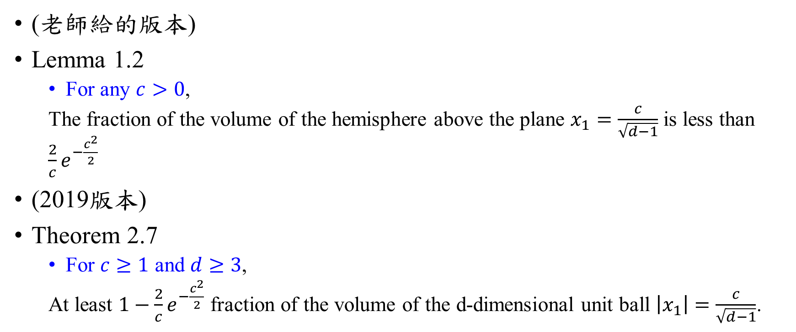
(老師給的版本)
Lemma 1.2
For any $c>0$,
The fraction of the volume of the hemisphere above the plane $x_{1}=\frac{c}{\sqrt{d−1}}$ is less than $\frac{2}{c}e^{−\frac{c^{2}}{2}}$
(2019版本)
Theorem 2.7
For $c≥1$ and $d≥3$,
At least $1−\frac{2}{c}e^{−\frac{c^{2}}{2}}$ fraction of the volume of the d-dimensional unit ball $\left|x_{1}\right|=\frac{c}{\sqrt{d−1}}$.

Slide 18
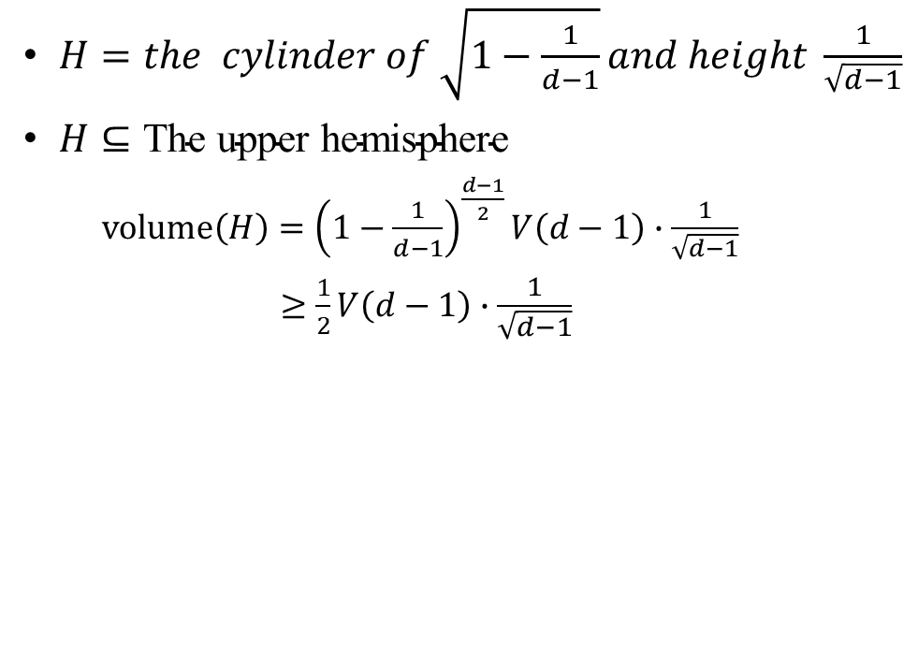
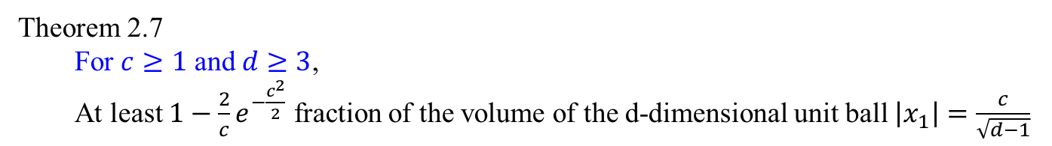
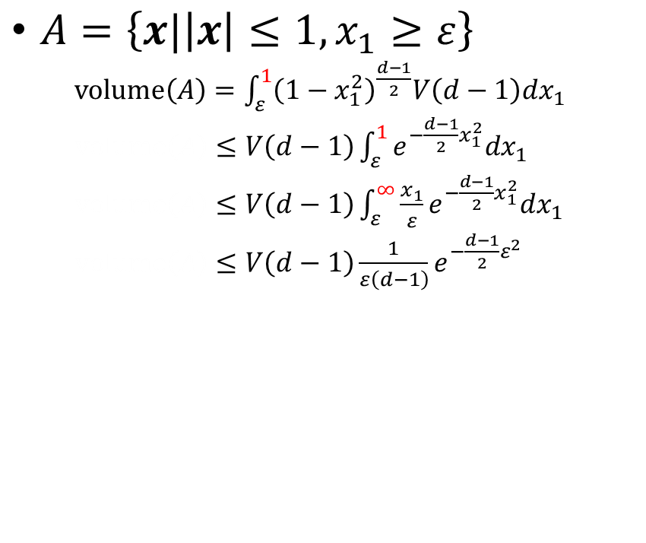
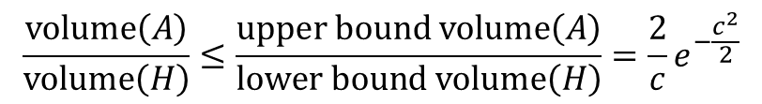


$$\frac{volume\left(A\right)}{volume\left(H\right)}≤\frac{upper bound volume\left(A\right)}{lower bound volume\left(H\right)}$$
$A=\left\{x|\left|x\right|≤1,x_{1}≥ε\right\}$
$volume\left(A\right)=\int_{ε}^{1}{{\left(1−x_{1}^{2}\right)}^{\frac{d−1}{2}}V\left(d−1\right)dx_{1}}$
$volume\left(A\right)≤V\left(d−1\right)\int_{ε}^{1}{e^{−\frac{d−1}{2}x_{1}^{2}}dx_{1}}$
$volume\left(A\right)≤V\left(d−1\right)\int_{ε}^{∞}{{\frac{x_{1}}{ε}e}^{−\frac{d−1}{2}x_{1}^{2}}dx_{1}}$
$volume\left(A\right)≤V\left(d−1\right)\frac{1}{ε\left(d−1\right)}e^{−\frac{d−1}{2}ε^{2}}$
$H=the cylinder of \sqrt{1−\frac{1}{d−1}}and height \frac{1}{\sqrt{d−1}}$
$H⊆\text{The} \text{upper} \text{hemisphere}$
$volume\left(H\right)={\left(1−\frac{1}{d−1}\right)}^{\frac{d−1}{2}}V\left(d−1\right)∙\frac{1}{\sqrt{d−1}}$
$volume\left(H\right)≥\frac{1}{2}V\left(d−1\right)∙\frac{1}{\sqrt{d−1}}$
$$\frac{volume\left(A\right)}{volume\left(H\right)}≤\frac{upper bound volume\left(A\right)}{lower bound volume\left(H\right)}=\frac{2}{c}e^{−\frac{c^{2}}{2}}$$
Theorem 2.7
For $c≥1$ and $d≥3$,
At least $1−\frac{2}{c}e^{−\frac{c^{2}}{2}}$ fraction of the volume of the d-dimensional unit ball $\left|x_{1}\right|=\frac{c}{\sqrt{d−1}}$
For $c≥1$ and $\frac{c}{\sqrt{d−1}}<1$, $d>c^{2}+1$

Slide 19



A Narrow Annulus
r
$$\frac{r}{d}$$
Consider any object $A$ in $ℝ^{d}$
A new object $\left(1−ε\right)A= \left\{\left(1−ε\right)x|x∈A\right\}$
$volume\left(\left(1−ε\right)A\right)={\left(1−ε\right)}^{d}volume\left(A\right)$
$\frac{volume\left(\left(1−ε\right)A\right)}{volume\left(A\right)}={\left(1−ε\right)}^{d}≤e^{−εd}$
$$↑$$
$$A$$
$$↓$$

Slide 20

The unit Sphere A Narrow Annulus
Theorem 2.8
Consider drawing $n$ points $x_{1}$, $x_{2}$,…, $x_{n}$ at random from the unit ball.
With probability $1−O\left(\frac{1}{n}\right)$
$\left|x_{i}\right|≥1−\frac{2\ln{n}}{d}$ for all $i$, and
$\left|x_{i}∙x_{j}\right|≤\frac{\sqrt{6\ln{n}}}{\sqrt{d−1}}$ for all $i≠j$.
與「Most of the volume near the boundary」相符
與「If we draw two points at random from the unit ball,
With high probability their vectors will be nearly orthogonal to each other.」相符

Slide 21
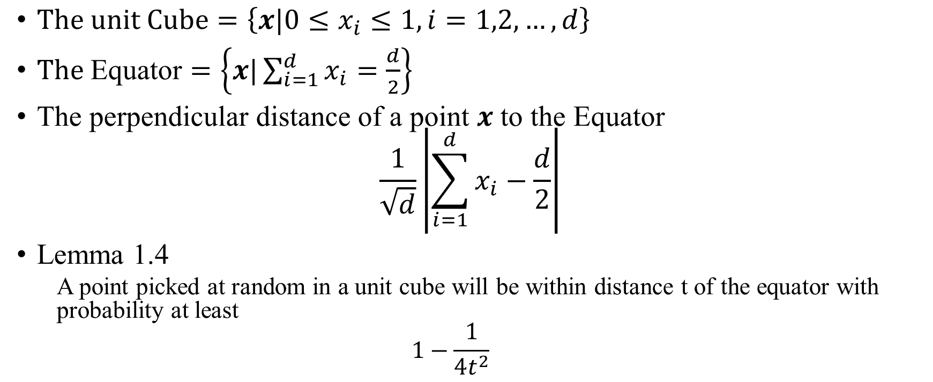
The unit Cube The Equator
$The unit Cube=\left\{x|0≤x_{i}≤1, i=1,2,…,d\right\}$
$\text{The} \text{Equator}=\left\{x|\sum_{i=1}^{d}{x_{i}}=\frac{d}{2}\right\}$
The perpendicular distance of a point $x$ to the Equator
$$\frac{1}{\sqrt{d}}\left|\sum_{i=1}^{d}{x_{i}}−\frac{d}{2}\right|$$
Lemma 1.4
A point picked at random in a unit cube will be within distance t of the equator with probability at least
$$1−\frac{1}{4t^{2}}$$

Slide 22
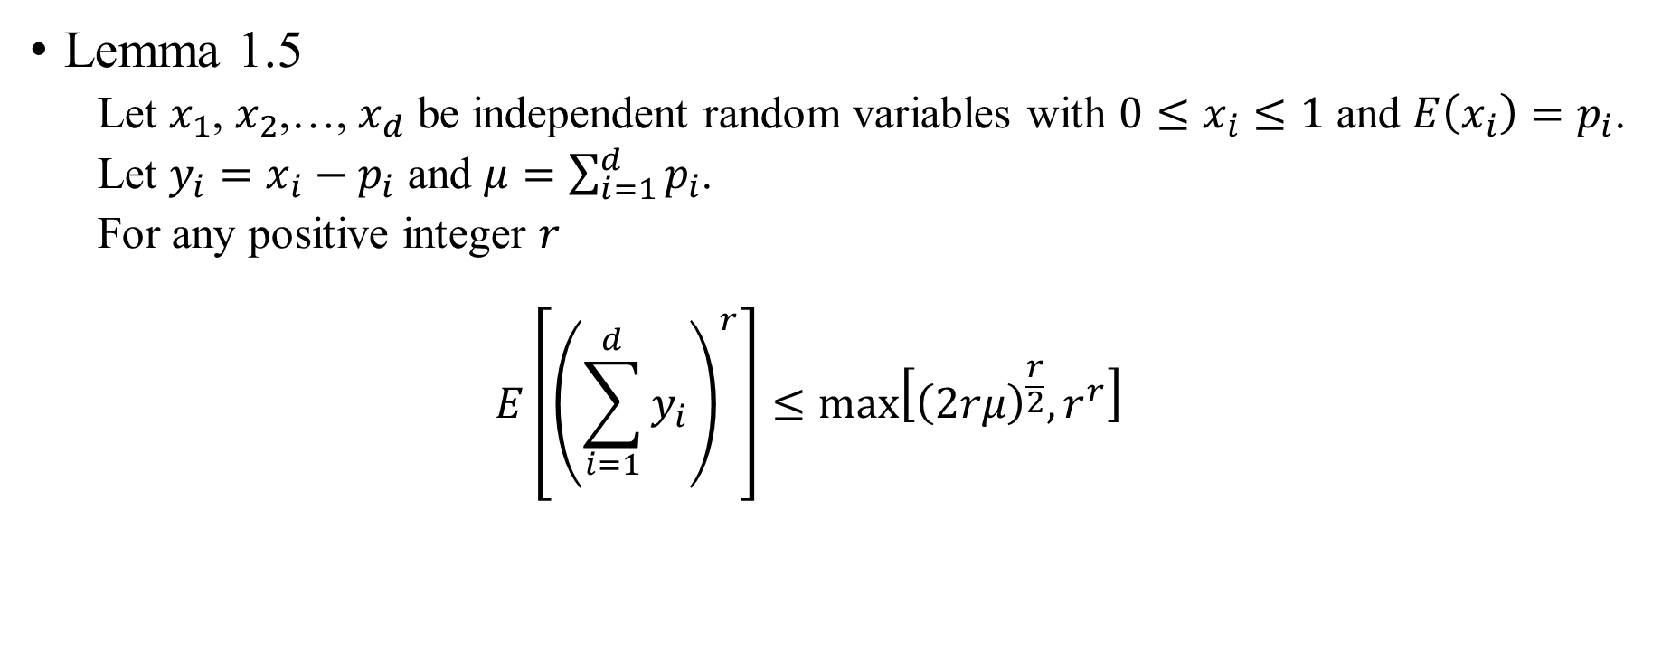
Lemma 1.5
Let $x_{1}$, $x_{2}$,…, $x_{d}$ be independent random variables with $0≤x_{i}≤1$ and $E\left(x_{i}\right)=p_{i}$.
Let $y_{i}=x_{i}−p_{i}$ and $μ=\sum_{i=1}^{d}{p_{i}}$.
For any positive integer $r$
$$E\left[{\left(\sum_{i=1}^{d}{y_{i}}\right)}^{r}\right]≤\max_{}\left[{\left(2rμ\right)}^{\frac{r}{2}}, r^{r}\right]$$

Slide 23
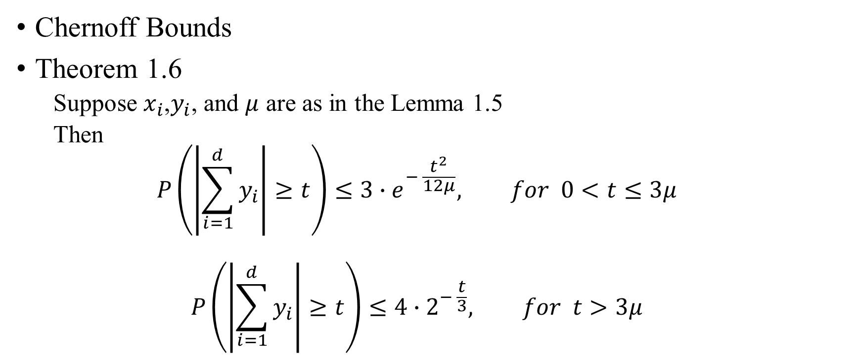
Chernoff Bounds
Theorem 1.6
Suppose $x_{i}$,$y_{i}$, and $μ$ are as in the Lemma 1.5
Then
$$P\left(\left|\sum_{i=1}^{d}{y_{i}}\right|≥t\right)≤3∙e^{− \frac{t^{2}}{12μ}}, for 0<t≤3μ$$
$$P\left(\left|\sum_{i=1}^{d}{y_{i}}\right|≥t\right)≤4∙2^{− \frac{t}{3}}, for t>3μ$$

Slide 24
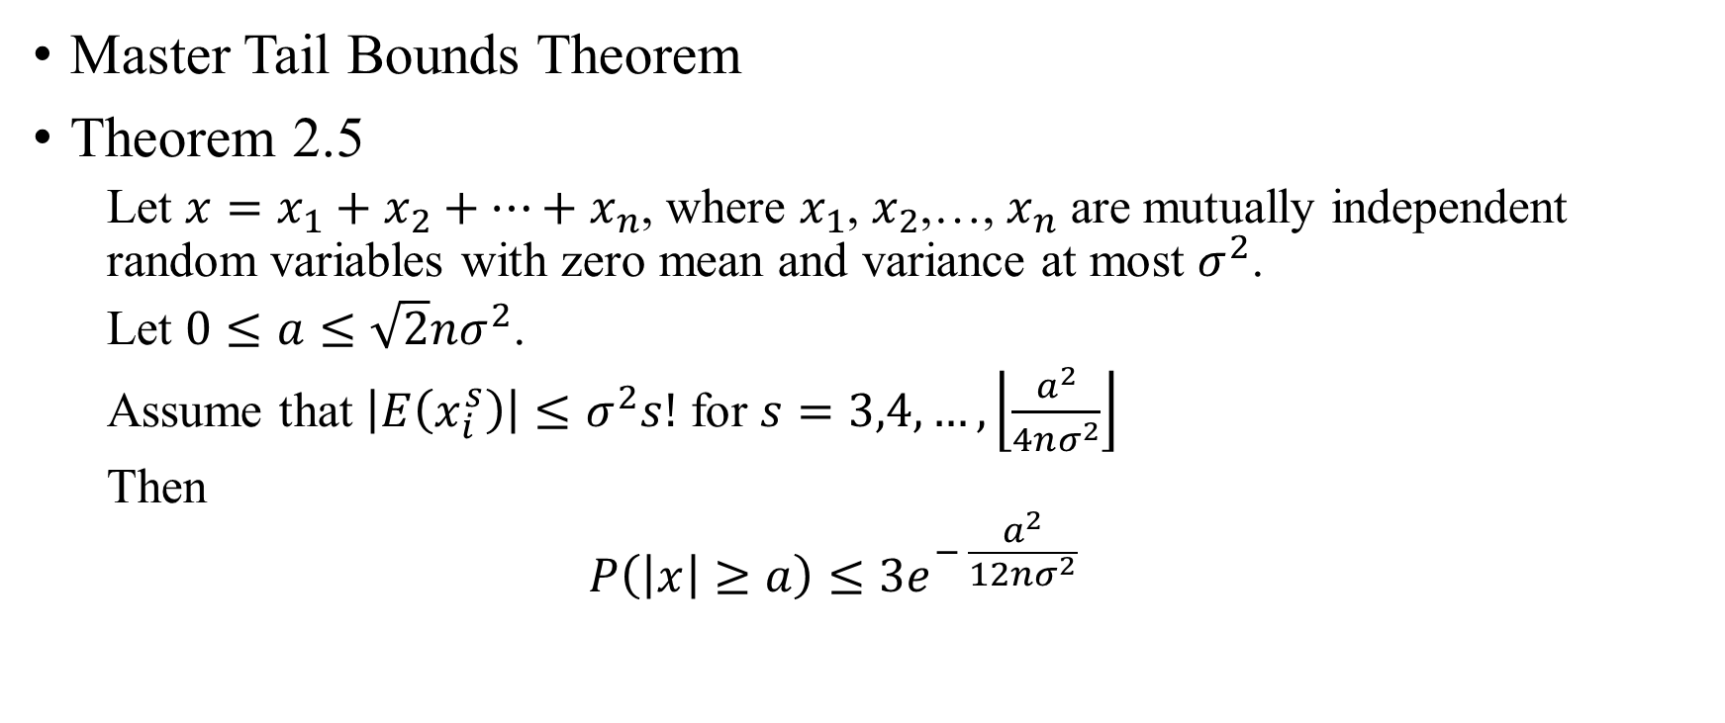
Master Tail Bounds Theorem
Theorem 2.5
Let $x=x_{1}+x_{2}+⋯+x_{n}$, where $x_{1}$, $x_{2}$,…, $x_{n}$ are mutually independent random variables with zero mean and variance at most $σ^{2}$.
Let $0≤a≤\sqrt{2}nσ^{2}$.
Assume that $\left|E\left(x_{i}^{s}\right)\right|≤σ^{2}s!$ for $s=3,4,…,\left\lfloor \frac{a^{2}}{4nσ^{2}}\right\rfloor$
Then
$$P\left(\left|x\right|≥a\right)≤3e^{− \frac{a^{2}}{12nσ^{2}}}$$

